Slide 1

Coop Profiler Value Proposition
Intelligent,Cultured, Intuitive

Slide 2

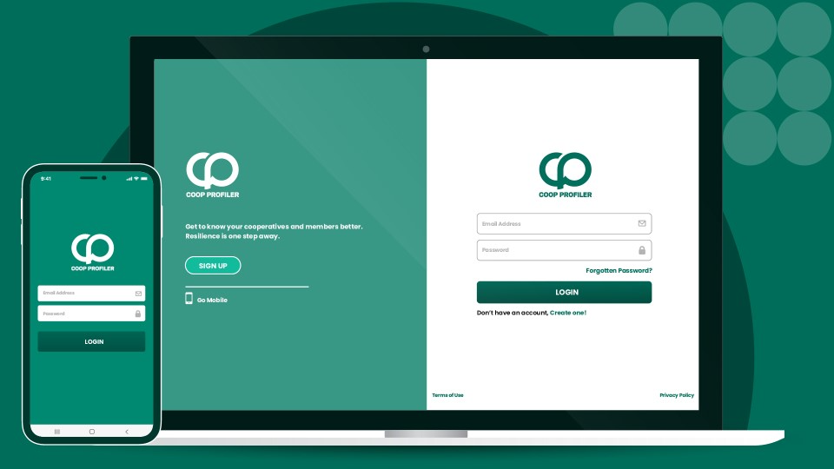

Slide 3
The problem
In most cases, cooperative managers and leaders do not have data on the holistic status of their cooperative and that of the members. They make decisions based on guess work and are often caught off-guard by both negative and positive disruptions.
Globally, there is no standardised tool that enables cooperative data aggregation, performance and resilience measurement based on the cooperative, fundamentals, values and principles. A few innovations not specifically aimed at measuring cooperative resilience but rather the financial performance of Savings & Credit Cooperative Organisations and agricultural cooperatives exist.
Furthermore, some cooperatives possess unequivocal control over personal and business data, this redirects power and benefits away from the owners of this data. For example most SACCOs often collect data at loan appriasal stage for the sake of the loan but don’t seek to understand if the cooperative products and services are meeting the members’ needs and expectations
Moreso, there are data silos enabled by duplicated affort in data aggregation, mostly devoid of collaborative functionalities that enhance standardised aggregation, storage, reporting, security and access which in turn faciliate uniformity and comparability.
Having looked at these challenges, the Uhuru Institute for Social Development developed the Coop Profiler and Cooperative Resilience Measurement Index which provide insights on the extent to which cooperatives and members are upholding the cooperative fundamentals, values and principles to become or remain collaborative, have a stong market position, be aware of what is happening in and around it, flexible, agile, adaptive to ICT and innovative solutions while ensuring its visibility amongst members and stakeholders facilitating a secure and sustainable approach to its internal and external environments

Slide 4
Our Solution
Coop Profiler is an agile research and decision support tool with inbuilt questionaires, analytics, reports and the Cooperative Resilience Measurement Index- a multi-dimensional resilience measurement a framework built on the backbone of cooperative identity; designed to power cooperative resilience and foster sustainable development by identifying business gaps and projecting solutions through collaborative data governance frameworks.
The software has been tailored for all types of cooperative businesses e.g. financial, agricultural, industrial, housing, manufacturing etc; government agencies, private sector e.g. banks, off takers and development partners. Partners can rank the data subjects based on differenet parameters and know how best to help them.
Data on individual members, groups and cooperatives are collected anytime and updated annually into a customised database and dashboard, which can be accessed independently by the cooperative along with its partners who would have been granted access by the data owners i.e. the cooperative. Access granted by the cooperative can be restricted or unrestricted depending on the agreed and documented agreement between the partners.
The software is accessible via web on www.coopprofiler.com. It has offline and online data aggregation along with internet powered analysis and document centre capabilities which provide a collaborative, standardised framework for competitive, antifragile and sustainably resilient cooperatives, partners and regulators thus the opportunity for shared and private gain.

Slide 5
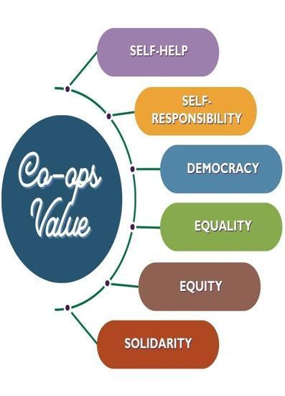
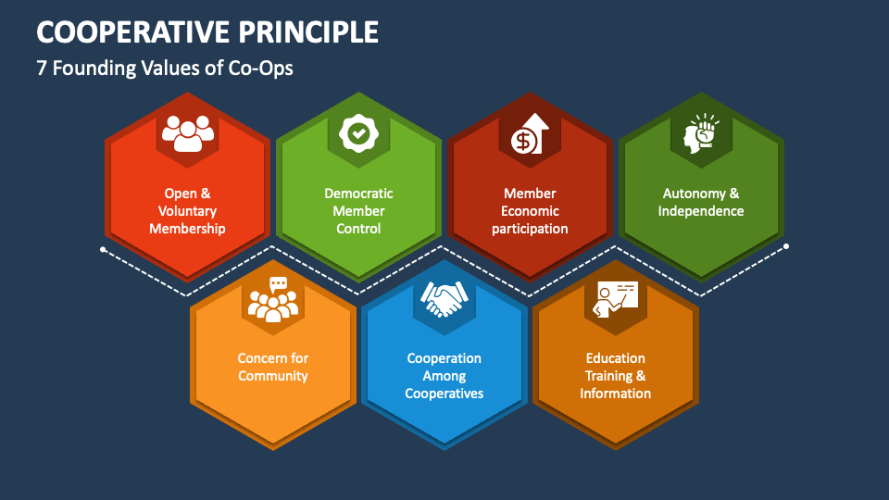
Our Solution
The software is powered by the individual and cooperative questionaires, baseline queries and the Cooperative Resilience Measurement Index(CRMI), the first of its kind in the world.
The CRMI tracks the levels of adherence to the ten cooperative values and the seven universal cooperative principles (as manifested in the individual and corporate organisation’s processes, behaviour, culture of membership and relevant stakeholders as well as the impact of the cooperatives in communities.
Fig.1: Traditional Values
Fig.2: Ethical values
Fig.3: Universal Cooperative principles
Honesty
Openness
Social Responsibility
Care for Others

Slide 6
Resilience Profiling & Measurement
PERFORMANCE RATINGS
Resilience Scores | Resilience Grading | Resilience Levels
90-100% | A+ | Ultra Resilient
80-89% | A- | Very Resilient
70-79% | B+ | Resilient
60-69% | B- | Moderately Resilient
50-59% | C+ | Mildly Resilient
40-49% | C | Low Resilience
< 40% | D | Very Low resilience
Traditional Values 0.5 (50%) | Ethical Values 0.2 (20%) | Principles 0.3 (30%)
Self- responsibility 0.1 (10%) | Honesty 0.07 (7%) | Open and Voluntary Membership 0.042 (4.2%)
Self-help 0.1 (10%) | Openness 0.04 (4%) | Member Democratic Control 0.054 (5.4%)
Equity 0.07 (7%) | Social Responsibility 0.06 (6%) | Member Economic Participation 0.042 (4.2%)
Equality 0.07 (7%) | Caring for Others 0.03 (3%) | Autonomy and Independence 0.036 (3.6%)
Solidarity 0.09 (9%) |  | Training, Education and Information 0.054 (5.4%)
Democracy 0.07 (7%) |  | Cooperation among Cooperatives 0.036 (3.6%)
 |  | Concern for Community 0.036 (3.6%)

Slide 7
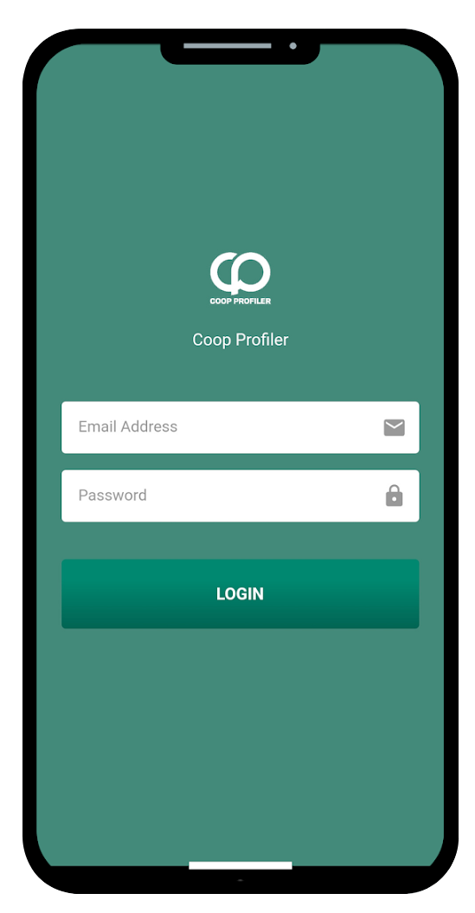
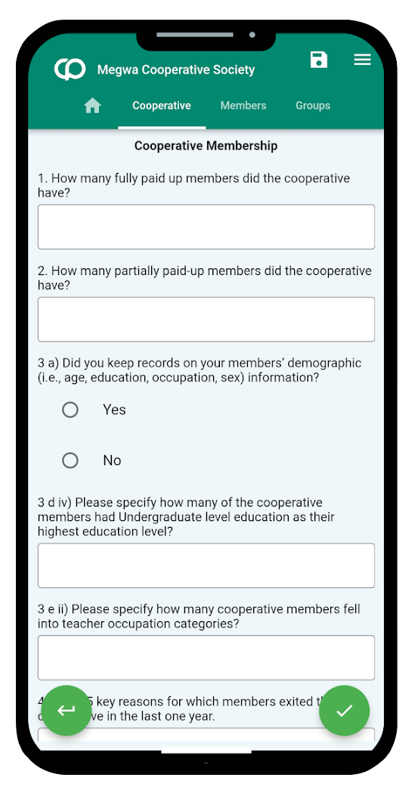
Coop Profiler’s Value Proposition
Establishing standards and uniformity in Holistic Data Aggregation, Measurement & Reporting
Coop Profiler enables standardisation in the institutional and household data by members to align with the cooperative statistical guidelines (ILO) which encourages compliance and comparability within a functional and collaborative sector ecosystem. The tool can for example enable the sector to know the regional performance of cooperatives based on the resilience index, at the same time enable the sector to understand what areas of capacity building and support may be priority need of cooperatives by region to bolster their stability and growth.
Coop Profiler is API enabled to promote collaboration, comparability, compliance monitoring and efficient regulation of cooperatives.
Through the API functionality, cooperatives, and partners can link Coop Profiler to existing software for data sharing which will reduce the resources for reinventing the wheel.

Slide 8
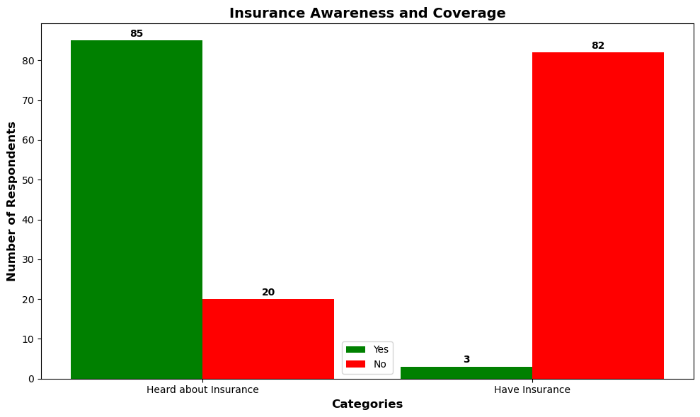
Sample analysis of individual members’ reasons for joining coop, aspirations in 5 years, and insurance uptake
Member Aspiration in 5 years
Members’ Insurance Uptake
Members’ reasons for joining cooperative
Aspiration | Respondent Numbers | %
Increase my savings | 81 | 77.14%
Increase my household income | 79 | 75.24%
I expect to have grown my business volume through borrowing | 69 | 65.71%
I will have grown in the leadership of the cooperative community | 70 | 66.67%
Easy access to money | 62 | 59.05%
To own property | 37 | 35.24%
To marry more women | 7 | 6.67%
Reasons | Number of members who gave these reasons
Farming inputs | 39
Training | 47
Marketing | 63
Savings | 37
Investment | 26
Business Networking | 49

Slide 9
Sample analysis of individual cooperative members’ Land Ownership, Incomes, Key Crops, Family Size
Table : Monthly Income Status
Table : Key Crops Grown by members
Description | Amount (UGX)
Average Monthly Income | 1,086,786
Maximum Monthly Income Recorded | 10,000,000
Minimum Monthly Income Recorded | 10,000
Crop | Male Farmers | Female Farmers | Total Farmers
Maize | 40 | 30 | 70
Cassava | 45 | 27 | 72
Rice | 13 | 10 | 23
Beans | 23 | 13 | 36
Soya Bean | 9 | 2 | 11
Sweet Potatoes | 17 | 12 | 29
Coffee | 9 | 2 | 11
Red Chili | 7 | 4 | 11
Others | 21 | 11 | 32
Table : Members’ Family Size
Family Size Range | Number of participants
NA | 7
1-5 | 66
6-10 | 26
11-15 | 4
16-20 | 0
21-26 | 2
Total | 105
Table : Members Land Ownership Status
Category | Percentage | Number
Have land | 90% | 94
Own land | 70% | 74
Use Land for Farming | 67% | 70
Total Acreage | --- | 698

Slide 10
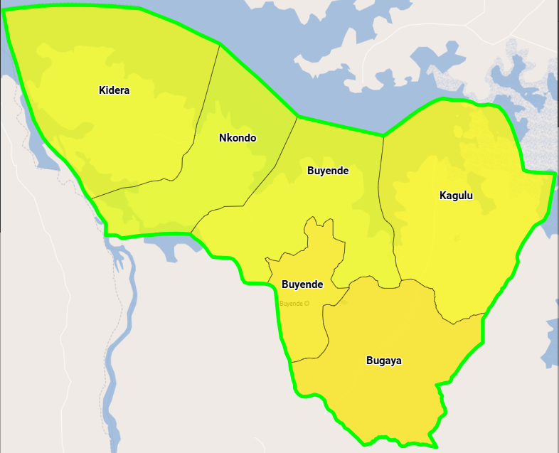
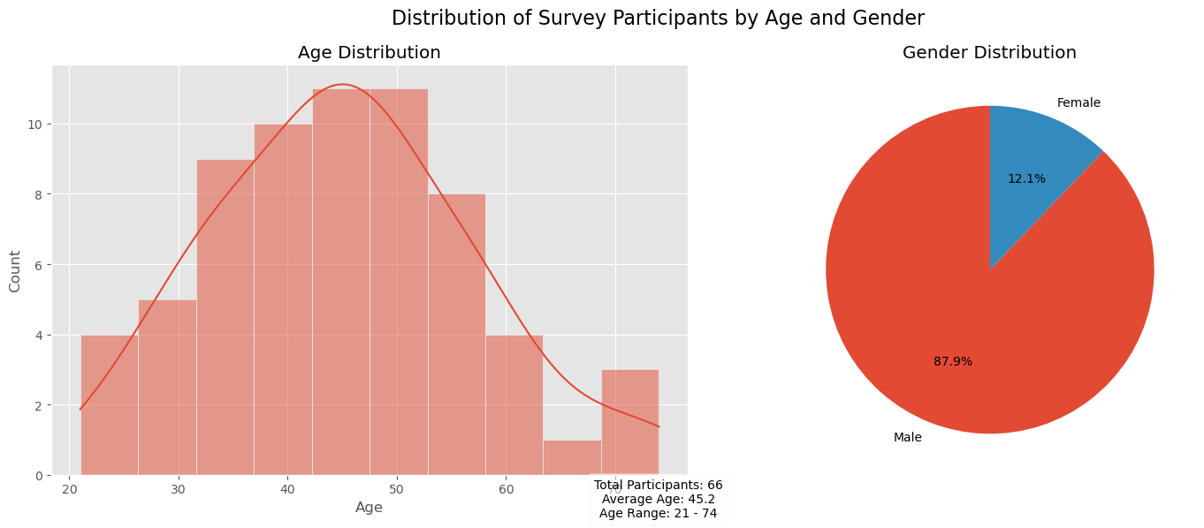
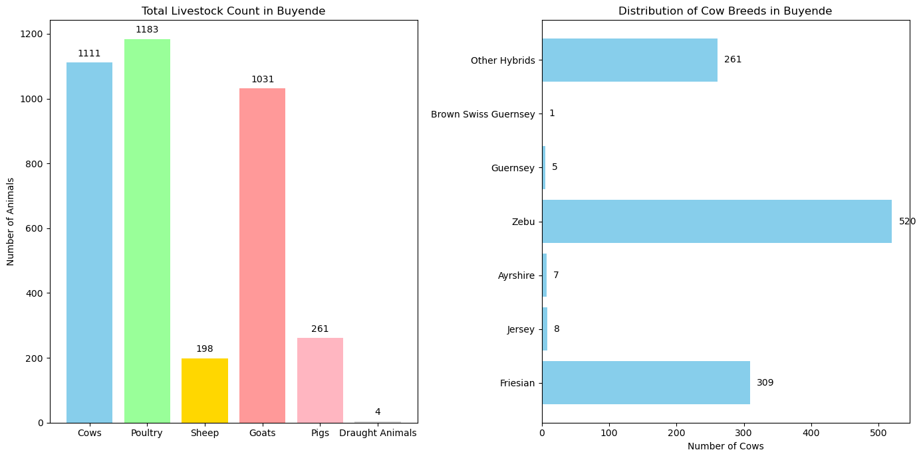
Sample analysis of individual cooperative members’ location, age distribution, gender, animal breeds
Sub County | Membership Count
Buyende | 25
Buyende Town Council | 44
Bugaya | 4
Nkondo | 2

Slide 11
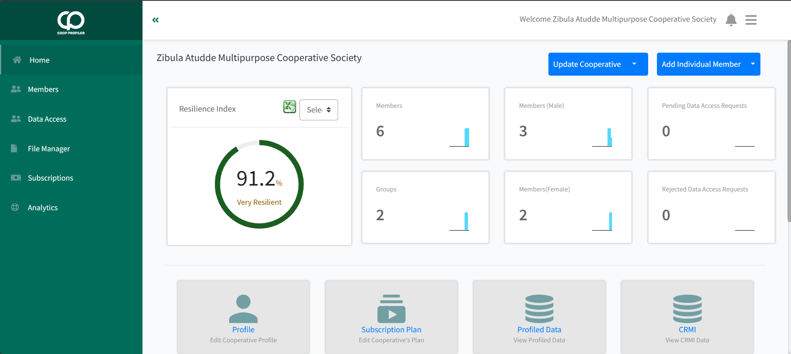
Sample Cooperative Resilience Scores for a dummy Cooperative

Slide 12
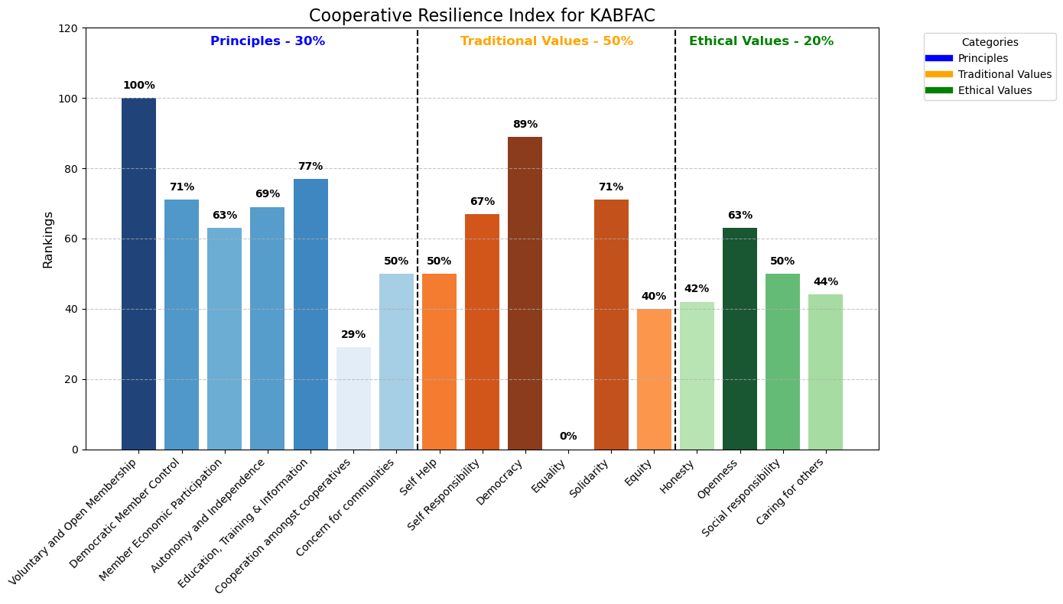
Sample Resilience Scores for XZY per Cooperative value and principle as at December 2024

Slide 13
Collaboration
Market Position
Sample Interpretation of XYZ Cooperative Organisation’s Systems Desirability
XYZ Coop demonstrates moderate collaboration:
89% in democracy, 71% in solidarity
Established committees for joint planning and operations
Regular meetings: monthly board, quarterly general, annual general
External partnerships: National Agricultural Research Centre, training institutions
To improve collaboration, XYZ Cooperative should:
Enhance cooperation amongst cooperatives (29% score)
Develop 10-year strategic plan
Develop business plans for various business units
Strengthen internal control policies
Introduce more membership welfare programs
Increase women's engagement in leadership
These efforts can address low scores in:
Cooperation amongst cooperatives (29%)
Equity (40%) and caring for others (44%)
Annual turnover: UGX 283,800,000
Shareholding: UGX 55,350,000
Net surplus: UGX 20,612,683
Key scores:
Member Economic Participation: 63%
Voluntary and Open Membership: 100%
Equity: 40%
Autonomy and Independence: 69%
Solidarity: 71%
Education, Training & Information: 77%
Cooperation amongst Cooperatives: 29%
Diverse income sources and enterprises
Future plans: High-quality cassava flour export, animal feed production
Challenges: Insufficient capital assets spread thin across many ventures.
Coop should consider prioritising

Slide 14
Coop Profiler’s Value Proposition
Data Democratization
To us data matters at a personal and institutional level and so we are intentional data aggregation, analysis, reporting and dissemination processes by involving the data subjects, aggregators and users in a collaborative manner
Our ethical and professional development and management of data resources inspires ownership and trust. Thus, the requirement for a collective effort in ensuring that data and its processes are authentic and reliable. Data integrity in terms of completeness, validity, reliability, accuracy, and consistency are integral principles that govern our functionality and usability. We believe that our software’s delivery is as good as the information that is fed in it. Like the good old ICT analogy “rubbish in, rubbish out” (RIRO), therefore all efforts towards cooperative data management and resilience measurement must be conscious of this and desist from any practices that compromise validity and soundness.
A Dynamic documents’ centre
Our robust document centre provides space for data validity to the extent that uploaded documents (registration certificates, audit reports, minutes of the general assembly and committee meetings) that have been attached are authentic and not cooked. When documentary evidence to support the information in the questionnaires are filed, the cooperatives, their partners, government, financiers can use them to perform their operational, monitoring, evaluation and regulatory work.

Slide 15
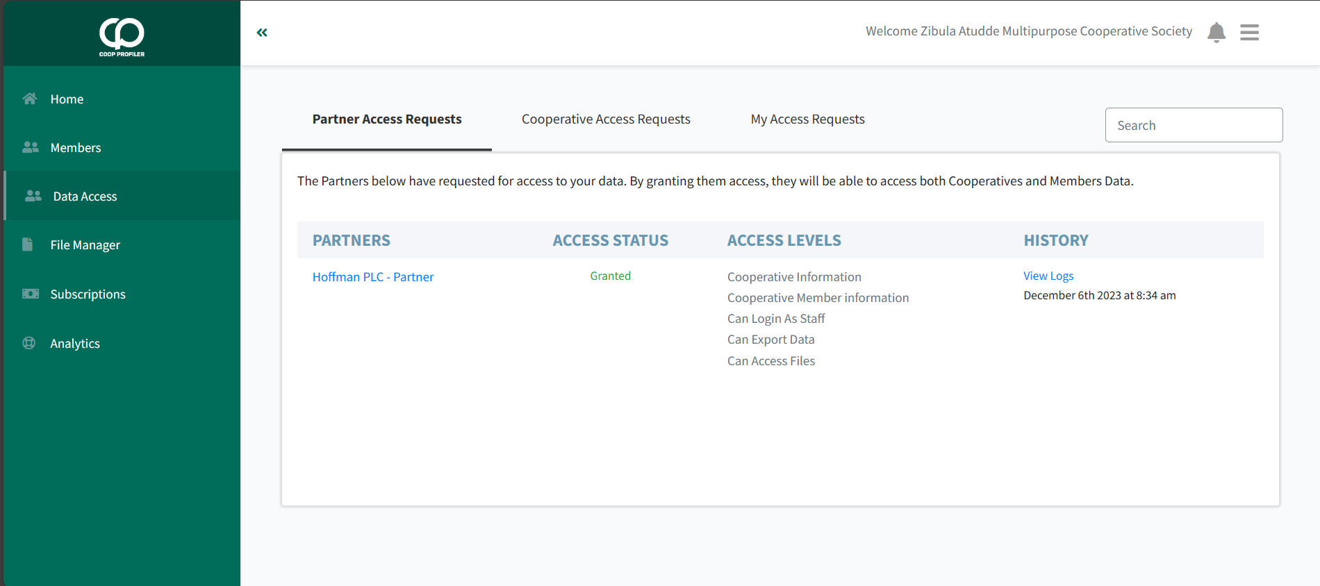

Slide 16
Coop Profiler’s Value Proposition
We operate in an ethical, transparent and compliant manner; TUI renews Coop Profiler’s licences on a yearly basis with the PDPO and NITA-U regulators.
Offline Capabilities: Allows data collection and synchronization even without internet access.
Data Confidentiality and Security are our priority
With Coop Profiler, the cooperative and its partners can aggregate data on members, groups and the cooperative for storage, and have it synced for collaborative decision support in an environment that promotes data confidentiality and security through privacy policies, data access and sharing authentication protocols that can be customised by each user type. The tool is automated for hourly backups that ensure data protection and safety.
All data types are secured by TUI the data custodian and the cooperative. The cooperative has all rights over its data, while TUI can only backup and can not use the data unless the cooperative has given it permission to do so as a partner or for approved research purposes.
Our product website is enabled with a cookies policy for permissions on whether certain user insights can be used for marketing purposes.
Collaborative Data Source: Enables partners to collaborate with cooperatives through the platform.
Affordable Pricing: Flexible pricing plans for primary cooperatives, secondary cooperatives, tertiary cooperatives and individual members of cooperatives.

Slide 17
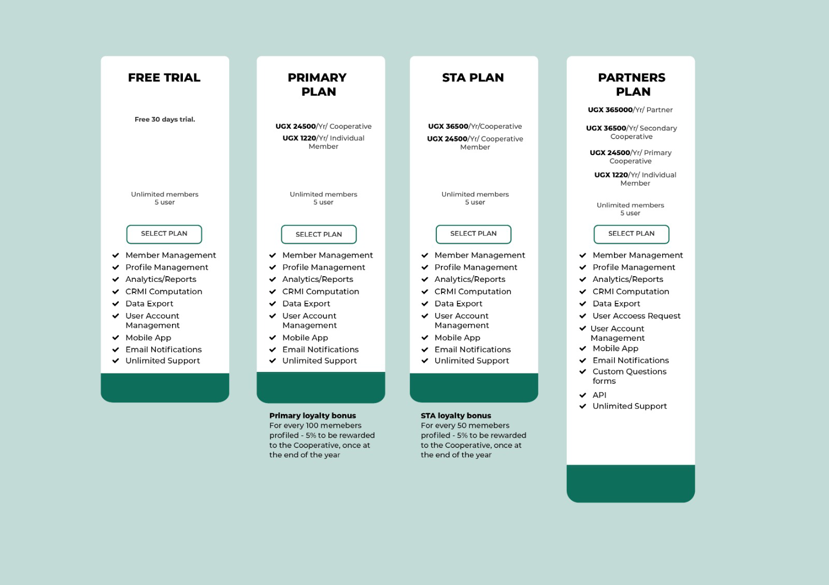

Slide 18

Coop Profiler’s Value Proposition
Intentional about innovating
Coop Profiler is conscious about constantly innovating and adapting technology that increases the tool’s value to the cooperative subsector. The mobile version has push notifications to facilitate timely updates. Through the pilot tests and market surveys, the team will continue to integrate all useful modules with a view of revolutionising the cooperative business sector.
We Share
To promote ownership and support growth, TUI has deployed a revenue sharing model that allows the data subject to benefit from a loyalty bonus program i.e. for every hundred individual members profiled the cooperative receives back 5% of the user fees paid
.

Slide 19

Coop Profiler’s Value Proposition
Training plus dedicated helpdesk ticketing
We are prepared and equipped to provide forward solutions and reduce the amount of effort and money wasted by enabling seamless operations and and a great user experience.
Our team of tech business development personnel, are available to provide training physically and using our virtual platforms like zoom and tele-conferencing.
In place is our customer experience function powered by competent staff who can be accessed physically and virtually via email, telephone, WhatsApp and the website.

Slide 20
How does Coop Profiler Benefit Coops
Personalized Services: By profiling members, the cooperative gains insights into individual needs and preferences, enabling the cooperative to offer tailored services and products that add value to members.
Equitable Resource Distribution: Understanding each member’s contributions and challenges helps cooperatives allocate resources more fairly and transparently.
Improved Access to Opportunities: Profiling uncovers opportunities like training, loans, and market access that members may otherwise miss out on.
Develops a culture: of collecting data and analyzing high quality data and accurate data within the cooperative.
Promotes digitalization: that improves management efficiency and precise business reporting.
Fosters evidenced based advocacy to policy makers based on real time accurate data.
Enhanced Support Services: With accurate data, the cooperative can offer better financial support (loans, savings schemes) and other services that meet member needs.
Data-Driven Growth: Members can track their individual performance and contributions over time, gaining access to personalized reports that help them grow.
Transparency and Accountability: Members can see how their data is used for decision-making, ensuring trust and transparency within the cooperative.
Collective Bargaining Power: Aggregated member data can enhance the cooperative’s ability to negotiate better deals, services, or grants, on behalf of all members.

Slide 21

Henry David Thoreau

Slide 22


